Slide 1
FIRST and FOLLOW
Course Code: CSC3220
Course Title: Compiler Design
Dept. of Computer Science
Faculty of Science and Technology
Lecturer No: | 9 | Week No: | 9 | Semester: | Fall 24-25
Lecturer: | Shahnaj Parvin

Slide 2
Lecture Outline
Review of Subset Construction Rule (NFA to DFA conversion)
Overview of First and Follow
First and Follow set Rules
Examples
Exercises

Slide 3
Objective and Outcome
Objective:
To Explain the necessity or requirement of FIRST and FOLLOW set calculation.
To elaborate the method/algorithm of FIRST and FOLLOW calculation from a given CFG.
To provide necessary example and exercise of FIRST and FOLLOW calculation from a given CFG
Outcome:
After this class the students will know the necessity of FIRST and FOLLOW calculation
After this class the students will be able to demonstrate the FIRST and FOLLOW calculation method.
The students will also be capable of calculating FIRST and FOLLOW set from a given CFG

Slide 4
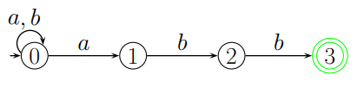
Review on NFA to DFA
Example
A NFA for the language, L3 = {a, b}∗{abb}.
Given NFA

Slide 5
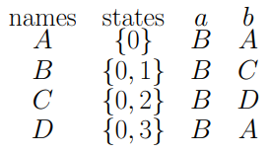
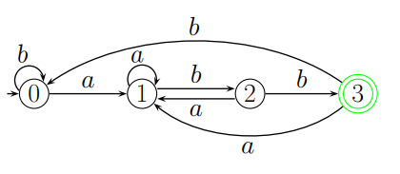
Review on NFA to DFA
Example
Converted DFA

Slide 6
FIRST and FOLLOW Overview
The basic problem in parsing is choosing which production rule to use at any stage during a derivation.
Lookahead
Means attempting to analyze the possible production rules which can be applied, in order to pick the one most likely to derive the current symbol(s) on the input.
FIRST and FOLLOW
We formalize the task of picking a production rule using two functions, FIRST and FOLLOW. we need to find FIRST and FOLLOW sets for a given grammar, so that the parser can properly apply the needed rule at the correct position.

Slide 7
FIRST Set Calculation
Rules
1. If X is terminal, FIRST(X) = {X}. 2. If X → ε is a production, then add ε to FIRST(X). 3. If X is a non-terminal, and X → Y1 Y2 … Yk is a production, and ε is in all of FIRST(Y1), …, FIRST(Yk), then add ε to FIRST(X). 4. If X is a non-terminal, and X → Y1 Y2 … Yk is a production, then add a to FIRST(X) if for some i, a is in FIRST(Yi), and ε is in all of FIRST(Y1), …, FIRST(Yi-1).
Applying rules 1 and 2 is obvious. Applying rules 3 and 4 for FIRST(Y1 Y2 … Yk) can be done as follows:
Add all the non-ε symbols of FIRST(Y1) to FIRST(Y1 Y2 … Yk). If ε ∈ FIRST(Y1), add all the non-ε symbols of FIRST(Y2). If ε ∈ FIRST(Y1) and ε ∈ FIRST(Y2), add all the non-ε symbols of FIRST(Y3), and so on. Finally, add ε to FIRST(Y1 Y2 … Yk) if ε ∈ FIRST(Yi), for all 1 ≤ i ≤ k.

Slide 8
First Set
The algorithm to compute the firsts set of a symbol X:
if(X is a terminal symbol):
first(X) = X;
break;
if (X -> ℇ ∈ productions of the grammar):
first(X).add({ ℇ });
foreach(X -> Y1....Yn ∈ productions of the grammar):
j = 1;
while (j <= n):
first(X).add({ b }), ∀ b ∈ first(Yj) ;
if ( ℇ ∈ first(Yj)):
j ++;
else:
break;
if(j = n+1):
first(X).add({ ℇ });

Slide 9
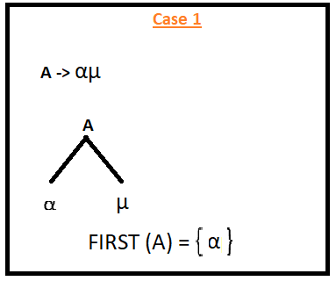
First Set (Case 1)
For a Production, if the first things is terminals that terminal (left most) would be considered as a ‘First’
If the Left most thing is a terminals then that terminals will be ‘First’
Don’t worry about the rest of the things residing on the right side of the first terminals

Slide 10
First Set (Case 2)
For a Production, if the first things is epsilon (ε) then ‘FIRST’ is epsilon (ε)

Slide 11
First Set (Case 3)
For a Production, if the first things is Non-Terminals, then we should continue until we found a terminals.
Look for the next production and next until we encounter a terminals

Slide 12

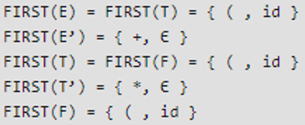
First Set (Example 1)
Problem
Solution

Slide 13

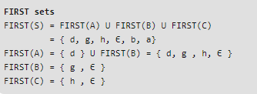
First Set (Example 2)
Problem
Solution

Slide 14
Follow Set
Rules
Follow should be look for right side of anything
Follow always starts with $
Follow(X) to be the set of terminals that can appear immediately to the right of Non-Terminal X in some sentential form.
FOLLOW (S) = { S } // where S is the starting Non-Terminal
If A -> pBq is a production, where p, B and q are any grammar symbols, then everything in FIRST (q) except ε is in FOLLOW (B)
If A->pB is a production, then everything in FOLLOW(A) is in FOLLOW (B)
If A->pBq is a production and FIRST(q) contains ε, then FOLLOW (B) contains { FIRST(q) - ε} U FOLLOW (A)

Slide 15
Follow Set
Rules
Apply the following rules: 1. If $ is the input end-marker, and S is the start symbol, $ ∈ FOLLOW(S). 2. If there is a production, A → αBβ, then (FIRST(β) – ε) ⊆ FOLLOW(B). 3. If there is a production, A → αB, or a production A → αBβ, where ε ∈ FIRST(β), then FOLLOW(A) ⊆ FOLLOW(B).
Note that unlike the computation of FIRST sets for non-terminals, where the focus is onwhat a non-terminal generates, the computation of FOLLOW sets depends upon where the non-terminal appears on the RHS of a production

Slide 16
Follow Set (Case 1-a)
Follow means something right behind of it.
Follow means the next one
If the next of a thing (whos Follow should be calculated) terminal/nonterminal then we must find the ‘FIRST’ of that terminal/nonterminal
That particular ‘FIRST’ would be the designated ‘FOLLOW’ of the things (whos Follow should be calculated)

Slide 17
Follow Set (Case 1-b)
Follow means something right behind of it.
Follow means the next one
If the next of a thing (whos Follow should be calculated) terminal/nonterminal then we must find the ‘FIRST’ of that terminal/nonterminal
That particular ‘FIRST’ would be the designated ‘FOLLOW’ of the things (whos Follow should be calculated)

Slide 18
Follow Set (Case 2)
We never write epsilon (ε) in ‘FOLLOW’
If we do not have anything on right side
That is, if we do not have an ‘FOLLOW’ then we will take the ‘FOLLOW’ (all FOLLOW) of its parent (non-terminal) (from which the production came)

Slide 19
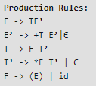
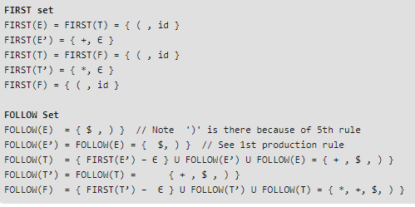
Follow Set (Example 1)
Problem
Solution

Slide 20

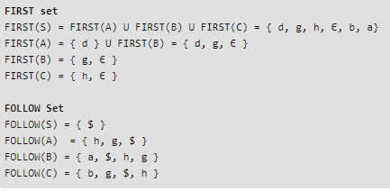
Follow Set (Example 2)
Problem
Solution

Slide 21
First and Follow Set
Example
Grammar | First | Follow
S->ABCDE | {a, b, c} | { $ }
A-a/epsilon | {a, epsilon} | {b, c}
B->b/epsilon | {b, epsilon} | {c}
C->c | {c} | {d, e, $}
D->d/epsilon | {d, epsilon} | {e, $ }
E->e/epsilon | {e, epsilon} | {$}

Slide 22
First and Follow Exercise 1
S → aBDh
B → cC
C → bC / ∈
D → EF
E → g / ∈
F → f / ∈

Slide 23
First and Follow Exercise 2
E → T X
X → + E
X → ε
T → int Y
T → ( E )
Y → * T
Y → ε

Slide 24
First and Follow Exercise 3
S → bSX | Y
X → XC | bb
X’→ CX’| ε
Y → b | bY
C → ccC | CX | cc

Slide 25
First and Follow Exercise 4
P → bSe
S → AR
R → AR | ε
A → id = E ;
E → FT
T → +FT | ε
F → (E) | id | a | b

Slide 26
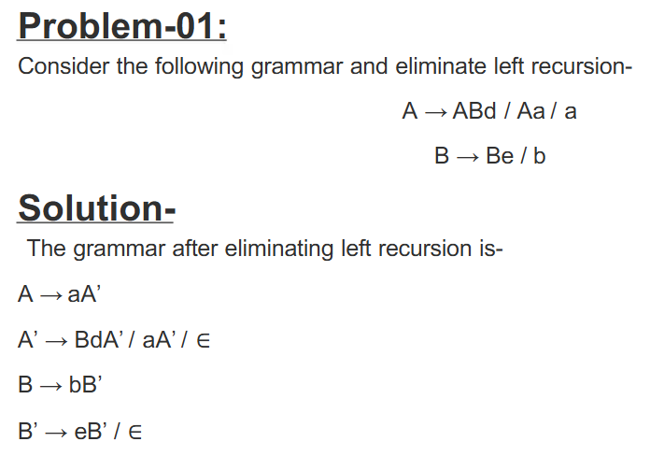
Left Recursion elimination

Slide 27
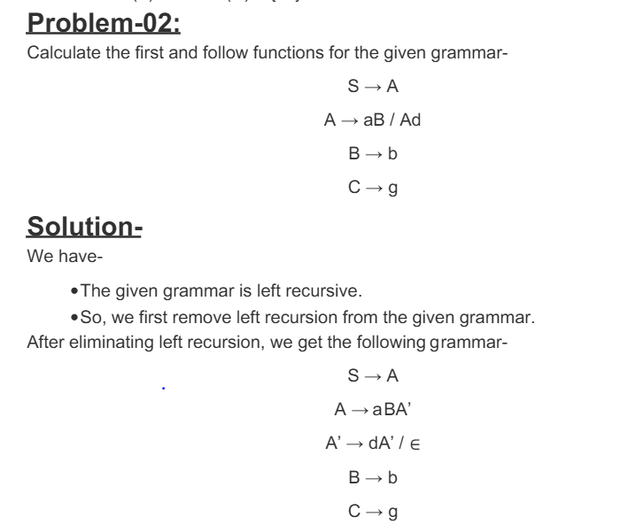

Slide 28
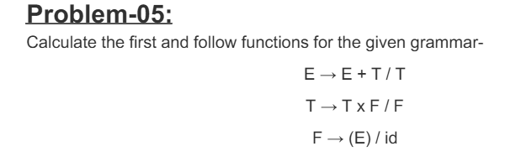
Try it Yourself

Slide 29
Lecture References
Online Tool:
http://jsmachines.sourceforge.net/machines/ll1.html
Online Tutorial
https://www.geeksforgeeks.org/why-first-and-follow-in-compiler-design/
Maynooth University Material
http://www.cs.nuim.ie/~jpower/Courses/Previous/parsing/node48.html
StackOverflow Explanation
https://stackoverflow.com/questions/3720901/what-is-the-precise-definition-of-a-lookahead-set

Slide 30
References/ Books
1. Compilers-Principles, techniques and tools (2nd Edition) V. Aho, Sethi and D. Ullman
2. Principles of Compiler Design (2nd Revised Edition 2009) A. A. Puntambekar
3. Basics of Compiler Design Torben Mogensen

